Slide 1

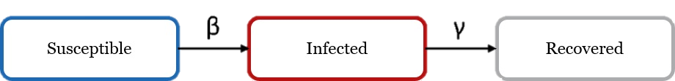
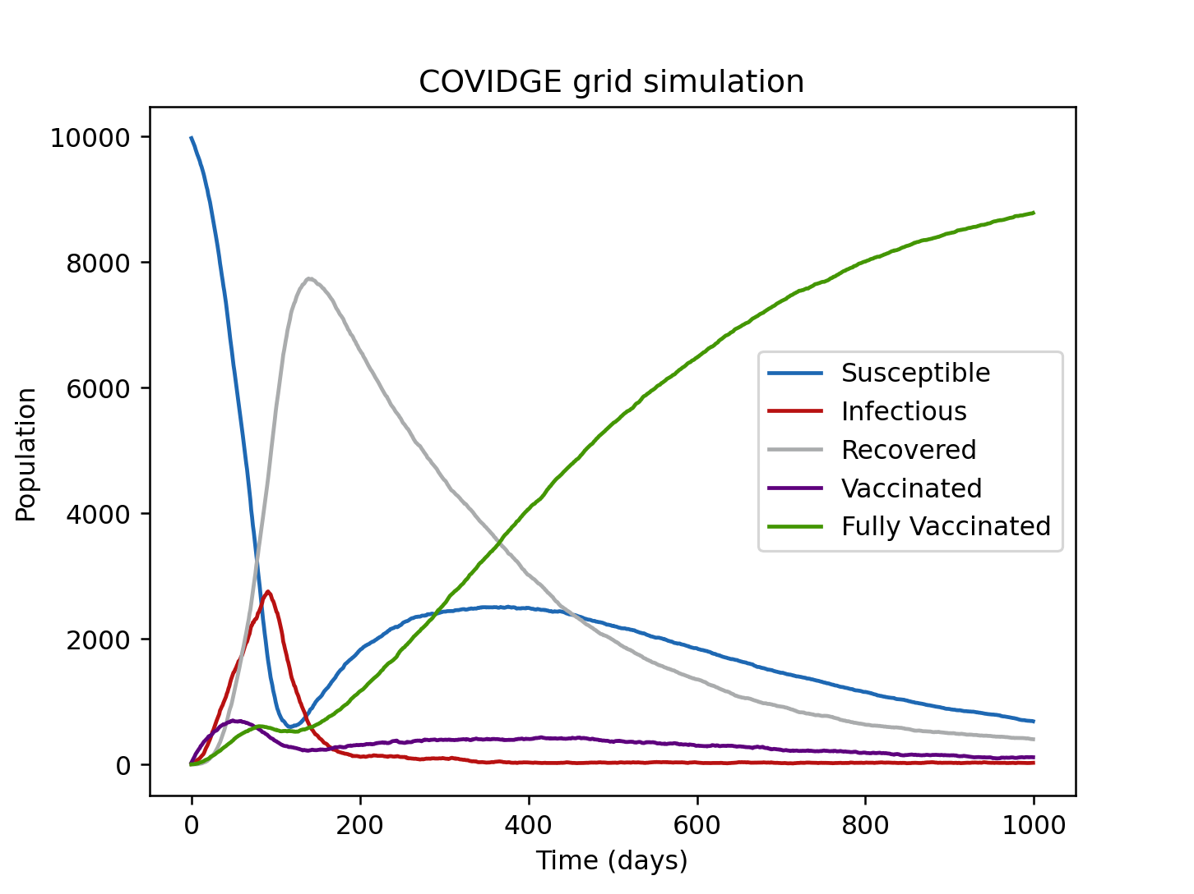
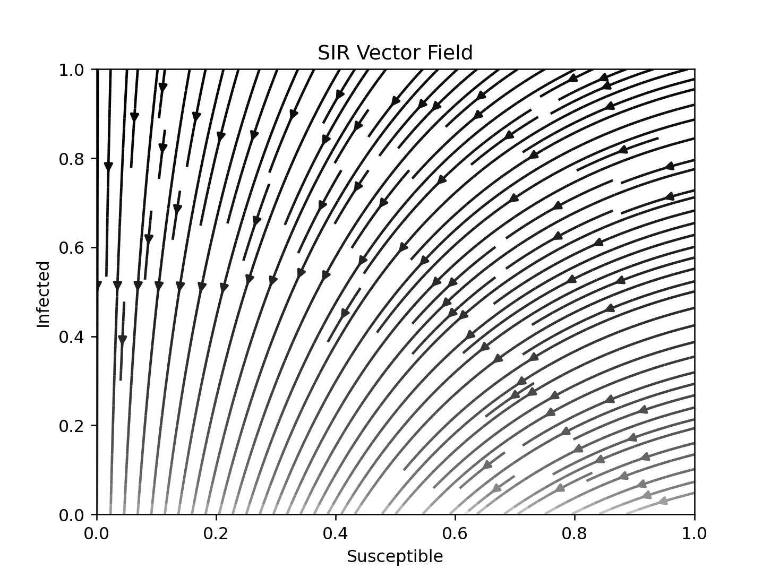
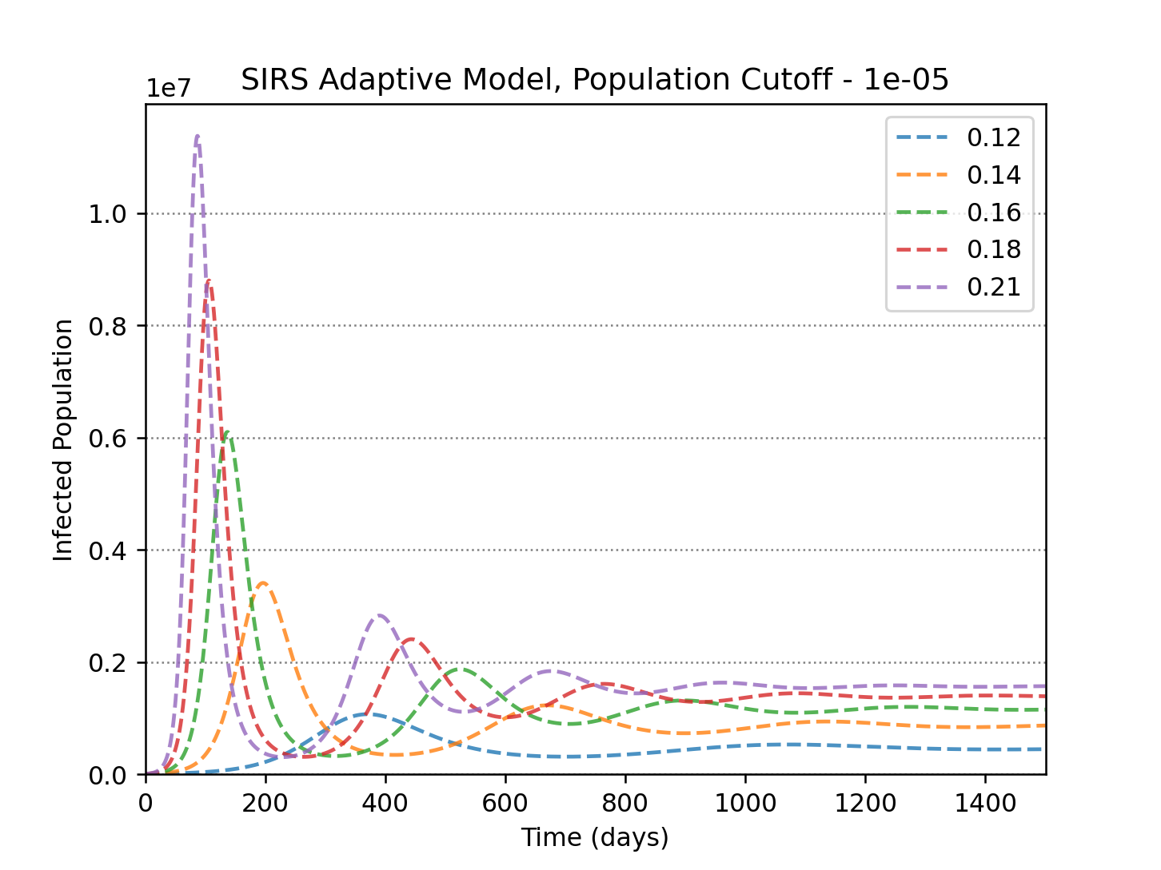
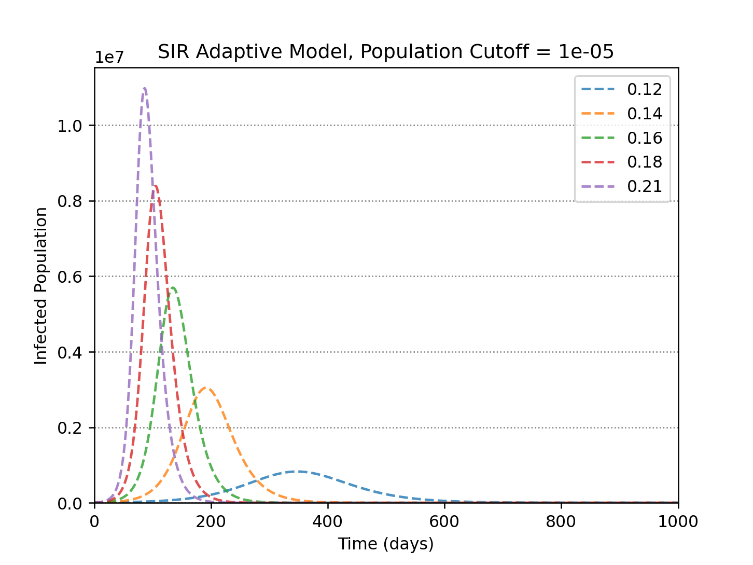
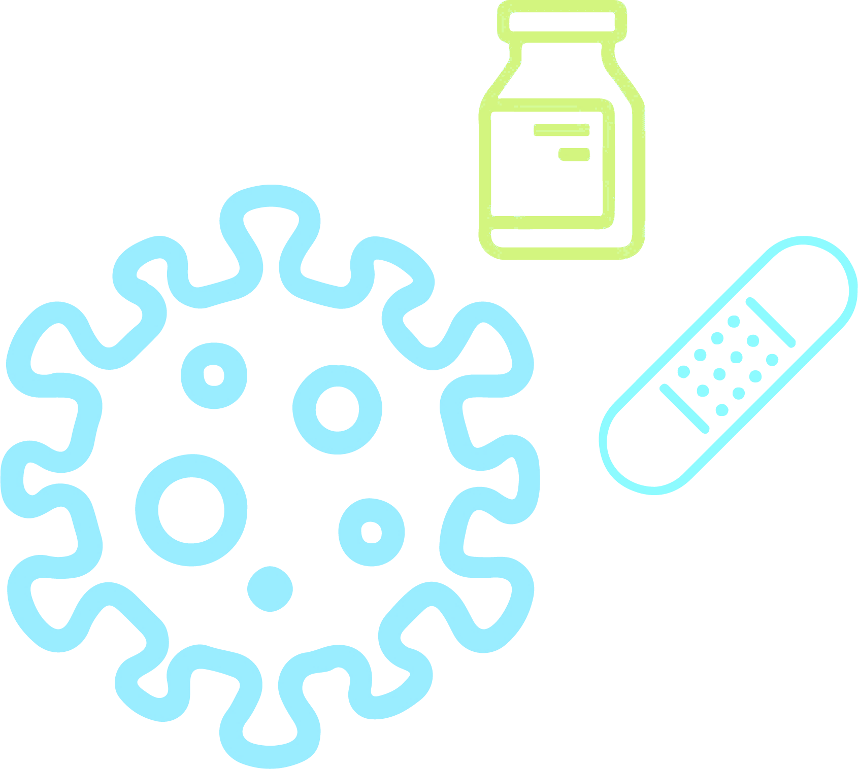
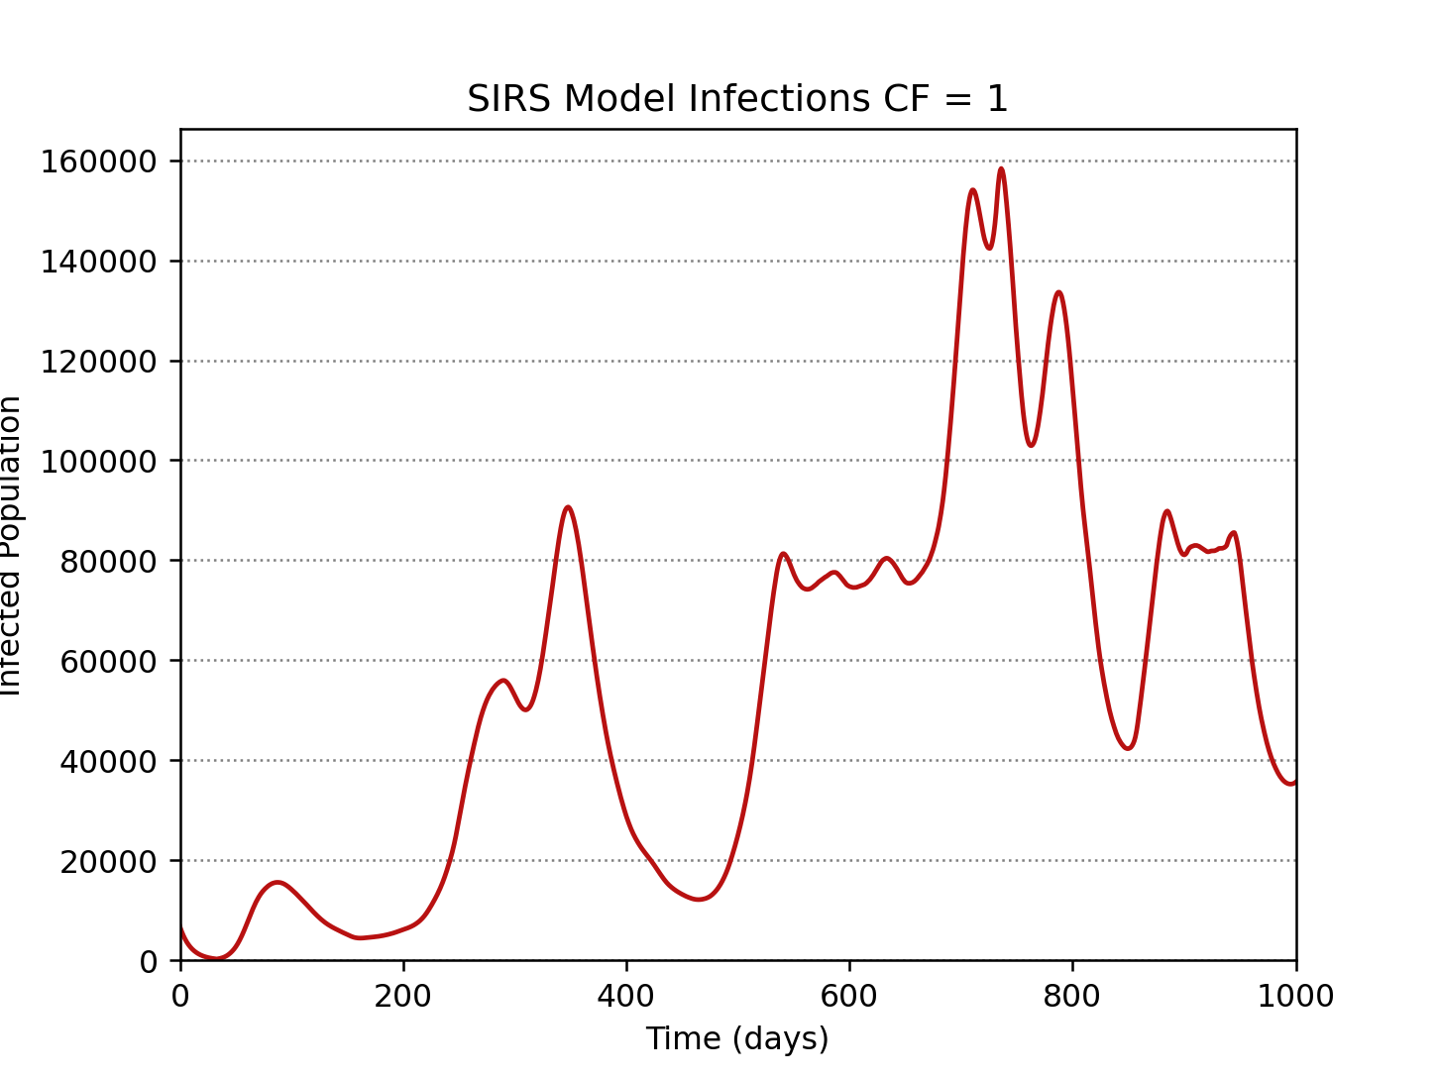
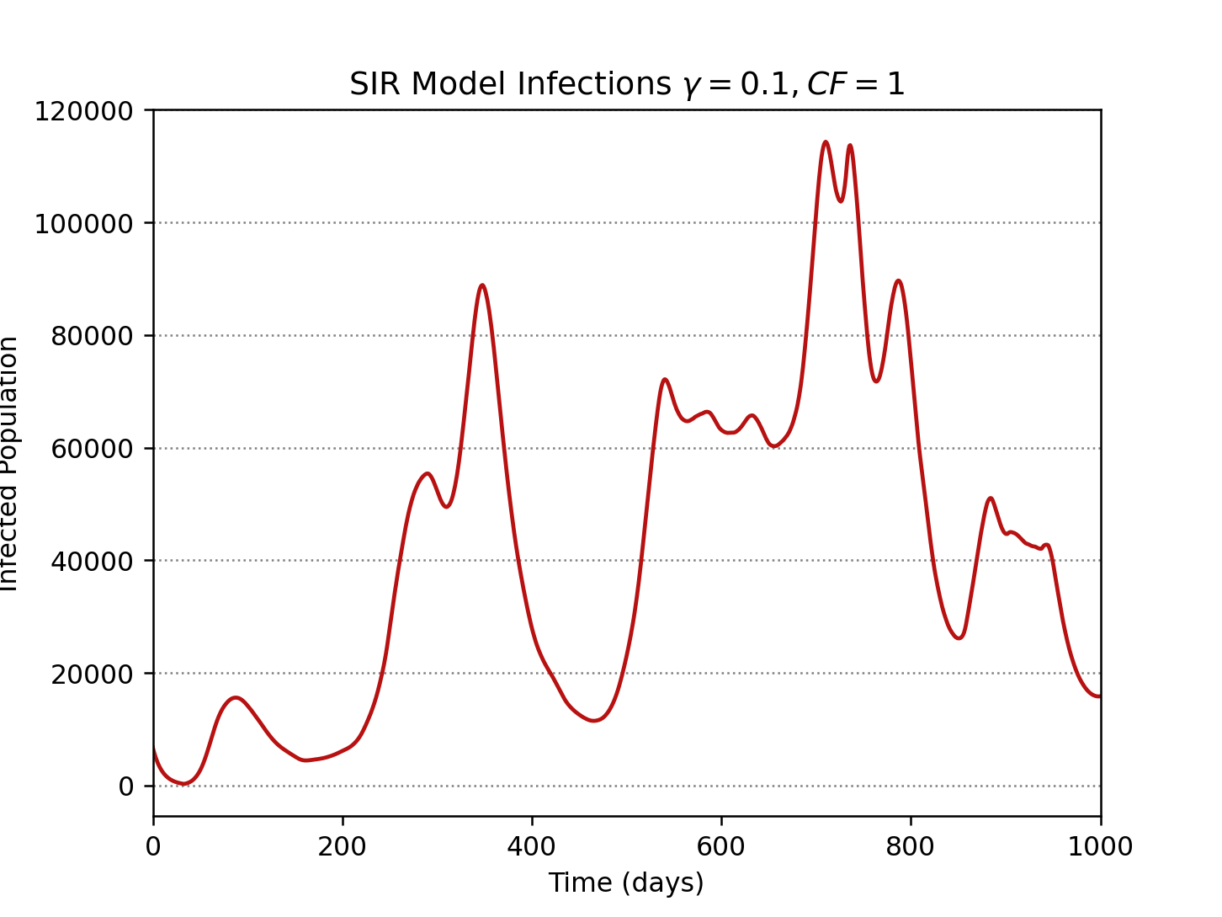

COVID-19 Compartmental Models
Finn John Onori
Supervisor: Prof. Graeme Ackland
Introduction
Methods
The Python programing language was used in this project with the numpy and matplotlib packages. Governments respond to a pandemic if the number of infections is high therefore adaptive models were created to replicate this. These models began with a constant contact rate with the contact rate decreased if number of infections surpassed a threshold.
This simulates a government going in and out of lockdown. The legends in the middle graphs represent the lowered contact rate that is set after the population threshold has been surpassed. For the lower graphs, a time dependant contact rate was deduced by multiplying an estimated reproductive rate by a recovery rate. This contact value could then be multiplied by a factor to weaken or strengthen lockdown.
Introduction
I analysed the British COVID-19 pandemic with compartmental models. I used SIR, SIRS, and a new model I created called COVIDGE. By studying compartmental models, it can be deduced how lockdowns are best implemented to help save lives. This poster
$$\frac{dS}{dt}=−β\frac{SI}{N}+ψR, \frac{dI}{dt}=β\frac{SI}{N}− γI, \frac{dR}{dt} = γI −ψR$$
Compartmental models are mathematical models that place individuals into one of several compartments. The SIRS model places individuals into three compartments: S (susceptible), I (infected), and R (recovered). The compartments change in size in accordance to the above differential equations.
Methods
Figure 1: Distribution of comment codes.
Results and Discussion
Result
The adaptive models gave some key insights. All models suggest that going into lockdown sooner causes there to be fewer infections overall, and that a stricter the lockdown reduces the peak of infections with the cost of the pandemic being extended in duration. This is vital in ensuring that emergency services are not overwhelmed. In the SIRS model, a stricter lockdown also results in a lower point of stability, however, this is somewhat undone when lockdown is lifted. All of this suggests that lockdown should be as strict as possible and be implemented as soon as possible to minimise deaths. However, lockdown guarantees economic damage therefore lockdown should only be put in place if an infection is dangerous.
When using real data it can be concluded that the models are incredibly sensitive. A contact rate that is ten percent greater causes more than a million
infections. Conversely, a contact rate that is ten percent smaller corresponds to fewer than ten thousand infections. What this suggests is that a
slight change can easily cause a second wave, therefore, lockdown must be lifted gradually. The COVIDGE model was the least accurate when
the same procedure was carried out as it always predicted a peak of over a million infections. The COIVDGE model provided more accurate
results if the incubation period approached zero. Therefore, this suggests further investigation is required for the exposed compartment.
Conclusion
Conclusions
These models provide a clear insight into the nature of pandemics and advise on how to proceed if treatments are not yet available. If an illness is confirmed to be deadly and highly infectious, then a strict lockdown should be implemented as quickly as possible to reduce the number of deaths. This will flatten the infection curve ensuring that emergency services will not be overwhelmed. Once an effective vaccine has been created, then as many people as possible should be given the vaccine to lower the number of infections that will be present in the endemic state. After this, lockdown can be lifted gradually to prevent a second wave. However, lockdowns cause immediate economic harm which may hinder a government's ability to develop an effective treatment. Therefore, Lockdowns should only be implement for a dangerous virus that is both infectious and deadly.

